Slide 1
Hello Everyone

Slide 2
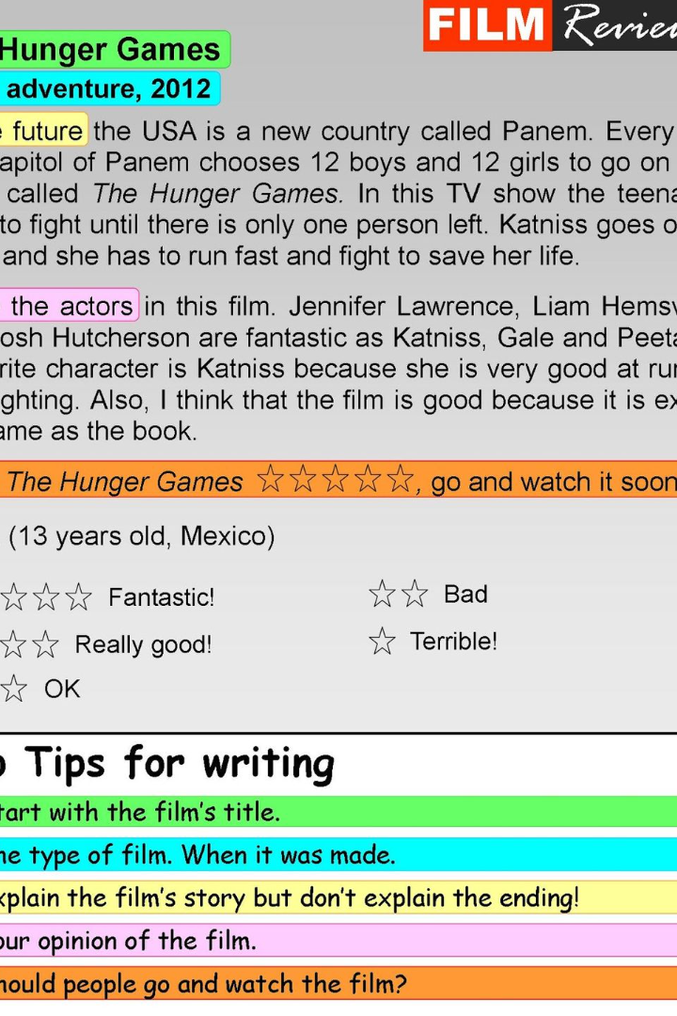
Introduction to IMDB Movie Analysis
IMDB Movie Analysis involves extracting valuable insights and trends from a dataset related to IMDB movies. This dataset provides a wealth of information, such as movie genres, durations, languages, and director details. By analyzing this data, we can uncover patterns and make informed decisions regarding movie production, distribution, and audience preferences.
sa
by shivangi gupta

Slide 3
Project Description
Scope
Dataset
Outcome
The project aims to analyze the IMDB movie dataset to uncover valuable insights and trends that can inform decision-making in the movie industry.
The dataset includes comprehensive details about movies, such as genres, durations, languages, and director information, providing a rich source for analysis.
The goal is to derive actionable insights that can be leveraged by stakeholders in the movie industry to make informed decisions and strategic choices.

Slide 4
Objectives
1
2
Genre Distribution Analysis
Movie Duration Analysis
Analyze the impact of genre on IMDB ratings through descriptive statistics.
Investigating the distribution of movie durations and its correlation with IMDB scores.
3
4
Language Distribution Analysis
Director Analysis
Assess the impact of language on IMDB ratings using descriptive statistics.
Analyze the contribution of directors to movie success through percentile calculations.
5
Budget Analysis
Explore the relationship between movie budgets and financial success.

Slide 5
Data Analysis: Explore relationships between variables such as genres, durations, languages, directors, and budgets.
Approach
1
Data Preparation
2
Exploratory Data Analysis (EDA)
Starting with data cleaning and organizing to ensure that the dataset is ready for analysis.
Explore relationships between variables such as genres, durations, languages, directors, and budgets.
3
Insight Generation
4
Report and Presentation
Use statistical analysis and visualizations to uncover patterns and trends.
Communicating findings and recommendations effectively through reports and presentations.

Slide 6
Data Cleaning
Missing Data Handling
Duplicates Removal
Normalization
Addressing and managing any missing or incomplete data points for accurate analysis.
Identifying and managing outliers to ensure the integrity and reliability of the dataset.
Transforming data into a standard format to maintain consistency and accuracy during analysis.

Slide 7
Exploratory Data Analysis (EDA)
Correlation Analysis
Outlier Detection
Analyzing the correlation between different variables to understand their relationships..
Identifying and analyzing outliers to understand their impact on the dataset and analysis results.
Feature Engineering
Summary Statistics
Creating new features or transforming existing ones to extract more meaningful insights from the data.
Descriptive statistics such as mean, median, mode, standard deviation, and range will be calculated for numerical variables

Slide 8


Tech Stack Used
Microsoft Excel
Microsoft PowerPoint
Utilized for data cleaning, organization, and initial exploratory analysis.
Utilized to create visual representations of data findings for effective communication.

Slide 9
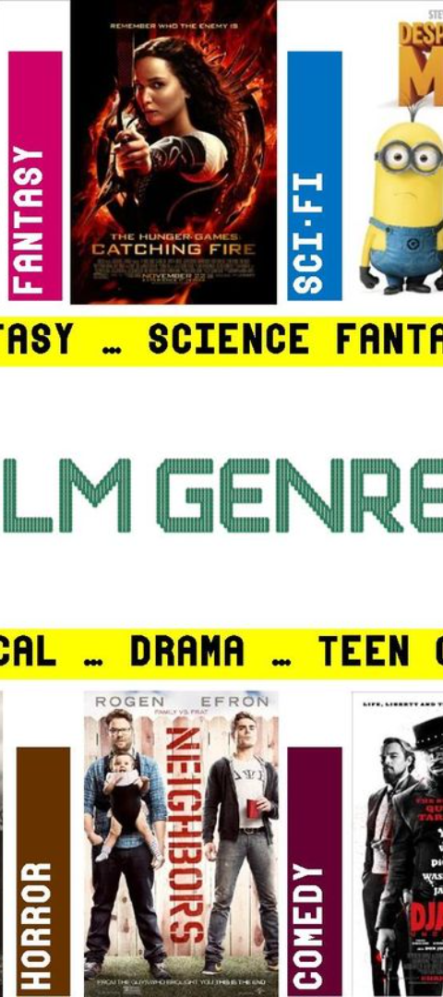



Movie Genre Analysis
Objective
Explore the distribution of movie genres and their impact on IMDB ratings.
Approach
Analyze frequency and rating statistics for each genre.
Impact Assessment
Assessing the impact of movie genres on audience engagement and box office performance.

Slide 10
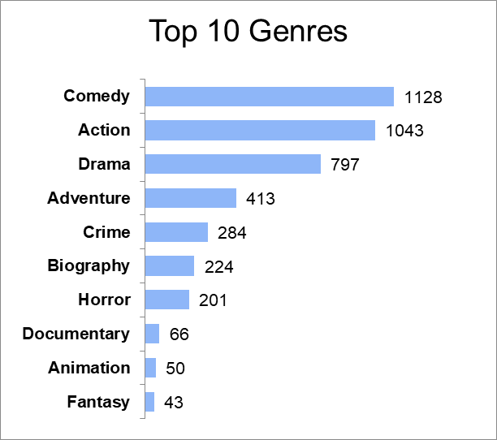
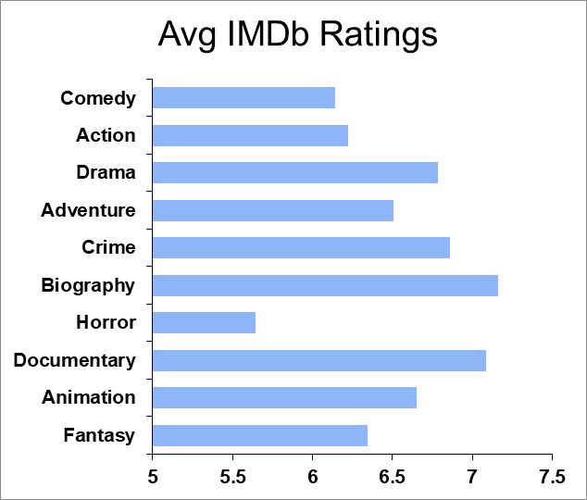
Findings
1
Genre Breakdown
2
Average IMDB Ratings by Genre
Genre Impact on Movie Ratings
Genres such as Drama, Biography, and Documentary tend to have higher and more consistent IMDB ratings, suggesting that these genres are generally well-received by audiences. On the other hand, genres like Action, Adventure, Comedy, and Crime display more varied ratings, with a wider range of audience reception.

Slide 11
Movie Duration Analysis
Objective
Analyze movie duration's influence on IMDB scores..
Approach
Examine summary statistics and visualize distribution using histograms.
Relationships
Explore correlation between duration and IMDB score through scatter plot and regression analysis.

Slide 12
Findings
Descriptive Statistics
Scatter plot
1
Movie Duration
Mean 108.6537
Median 104
Standard Deviation 23.11172
2
Imdb Scores
Mean 6.414764
Median 6.5
Duration Impact on Movie Ratings
Standard Deviation 1.121372
An increase in movie duration is associated with a higher impact on IMDB ratings, as evidenced by a positive linear regression equation

Slide 13

Language Analysis
Objective
1
Examine movie distribution based on language and assess their impact on IMDB scores.
2
Approach
Analyze descriptive statistics to understand the relationship between language and IMDB scores.
Impact assessment
3
Compare statistics to discern the influence of language on movie ratings..

Slide 14
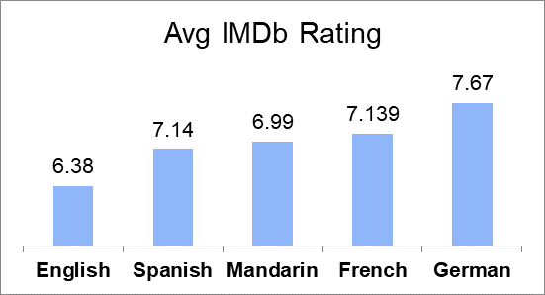
Findings
Duration Impact on Movie Ratings
Language Preference
Dataset predominantly features movies in English, which accounts for a large number of entries.
French, Spanish, and Mandarin language movies tend to have higher average ratings compared to English, with German language movies having the highest average rating.
The higher average ratings for certain non-English language movies may indicate a strong reception from audiences who appreciate foreign language cinema.
1
2
3

Slide 15
Director Analysis
1
2
Objective
Approach
Investigate the influence of directors on movie ratings.
Calculate the average IMDB score for each director based on their movies..
3
Impact Assessment
Compare the percentile scores of top directors with the overall distribution of IMDB scores..

Slide 16
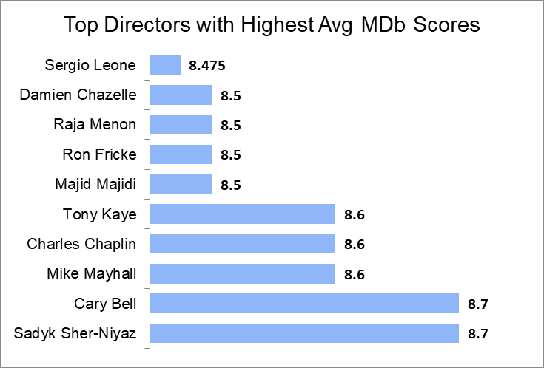
Findings
Top Directors by Average IMDB Scores
Top IMDB score 8.7
Percent Rank in dataset 0.999
Percentile 8.7
Director’s influence on ratings
Director associated with a movie achieving this top IMDB score of 8.7 holds a significant position in the top percentile of directors in the dataset. This implies that these directors have a track record of producing exceptionally well-received movies, warranting further exploration of their influence on movie success within the dataset.

Slide 17
Budget Analysis
1
2
3
Objective
Approach
Impact Assessment
Explore the relationship between movie budgets and their financial success.
Analyze the correlation between movie budgets and gross earnings, and identify the movies with the highest profit margin.
Explore the correlation coefficient between movie budgets and gross earnings

Slide 18
Findings
Correlation between Budget and Gross Earnings
Movies with Highest Profit Margin
Correlation Coefficient 0.0964902
Movies Profit Margin
Avatar 523.505
Director’s influence on ratings
Jurassic World 502.177
Based on the correlation coefficient of 0.096490202, which indicates a relatively weak positive linear relationship between the movie titles and their highest profit margins. This suggests that the budget analysis may not have a strong direct impact on the movies' profit margins.
Titanic 458.672

Slide 19
Conclusions
Movie Genres: Genres such as Drama, Action, Adventure, comedy, and Crime being the most prevalent.
Movie genres, duration, language, directors, and budget all have significant impacts on movie success on IMDB.
Movie Duration: An increase in movie duration is associated with a higher impact on IMDB ratings.
Languages: French, Spanish, and Mandarin language movies have higher average ratings compared to English, with German language movies having the highest average rating.
Director’s Impact: Director associated with a movie achieving this top IMDB score of 8.7 holds a significant position in the top percentile of directors .
Budget: Correlation coefficient of 0.096490202, which indicates a relatively weak positive linear relationship. Budget analysis may not have a strong direct impact on the movies' profit margins.

Slide 20
Limitations
1
2
The dataset may not capture all relevant factors affecting movie success, and further exploration could include additional variables such as marketing strategies or audience demographics.
The analysis is limited by the quality and completeness of the dataset, which may vary across different sources.

Slide 21
Thank You…

